Slide 1
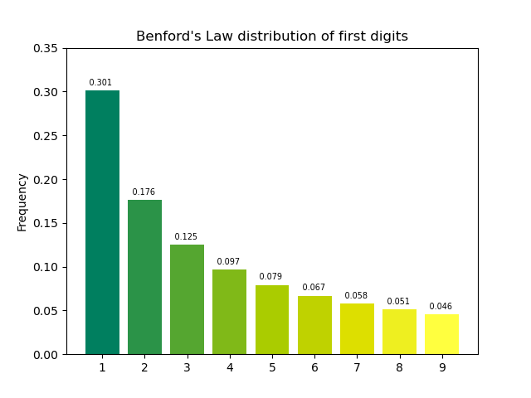
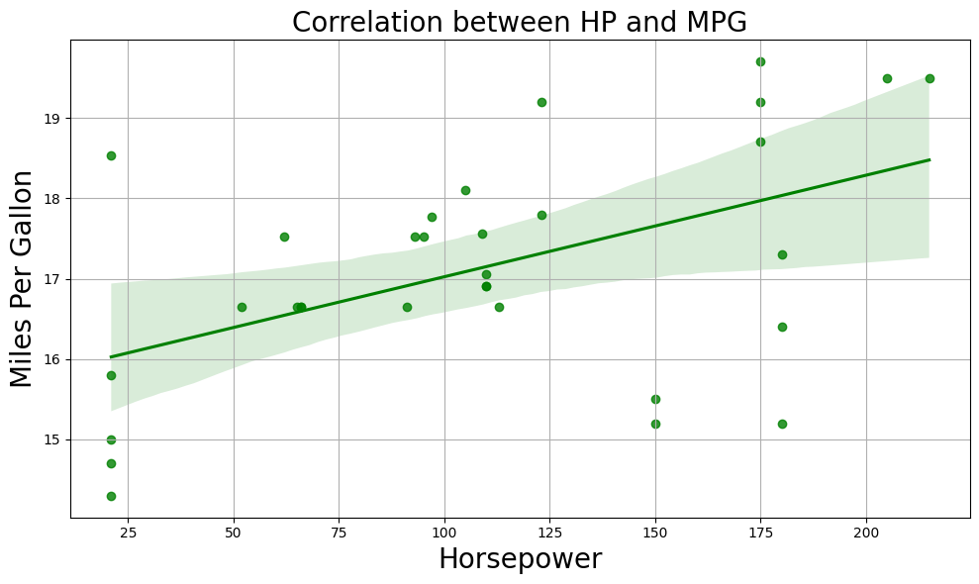
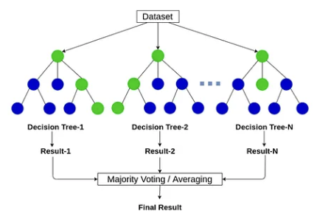
Detection of Correlation Reversal Manipulation
via Benford’s Law and Random Forest
Benford’s Law
(Statistical Analysis)
“The more horsepower we have,
the more miles per gallon we get.”
Random Forest
(Machine Learning)
Detect Frauds
Data Manipulation
Correlation Reversal

Slide 2
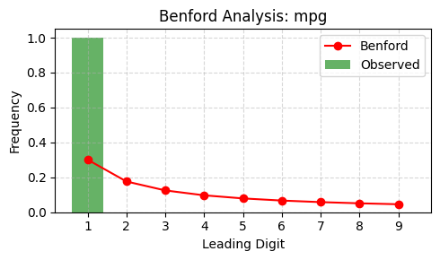
Detect Manipulation using Benford’s Law
Chi-square = 74.3017, p-value = 0.0000000000006
Criteria: Chi-square > 30.58 and p < 0.0001
Classified as Benford Anomaly and extreme

Slide 3
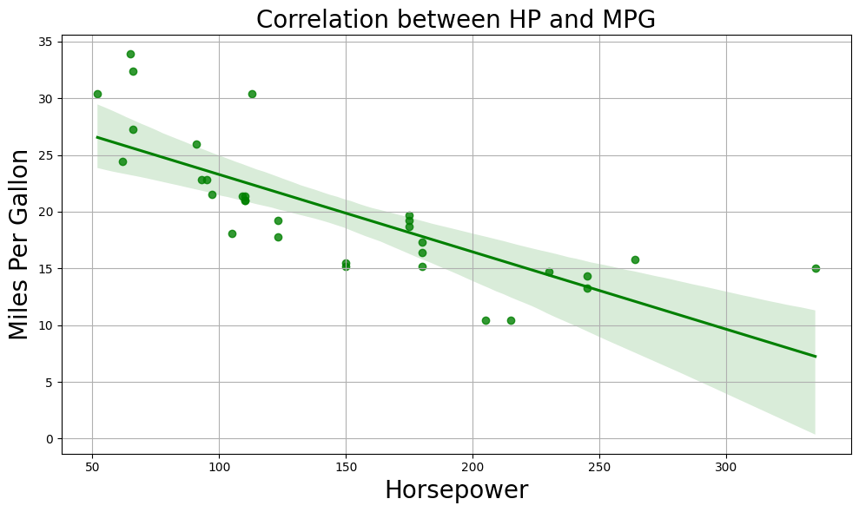
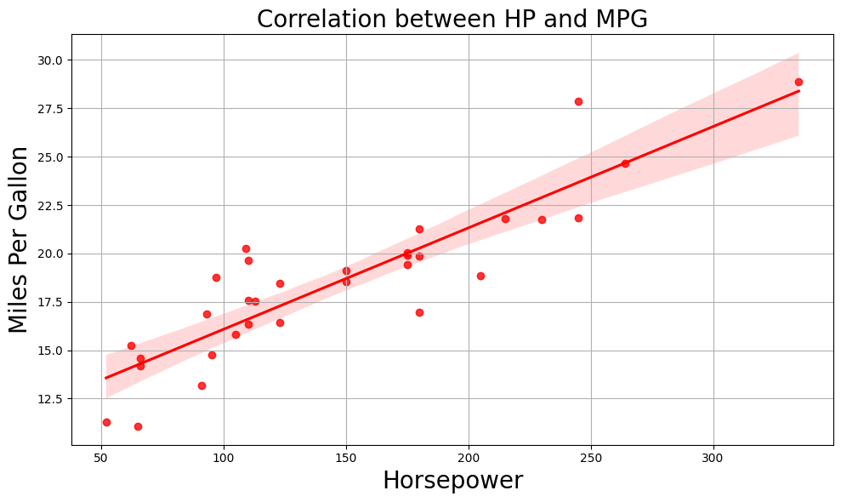
Detect Manipulation using Random Forest
Original Data (Label=0)
Supervised Training
RF Model
Manipulated Data (Label=1)
New Manipulated Data
Classified
RF Model
As manipulated

Slide 4
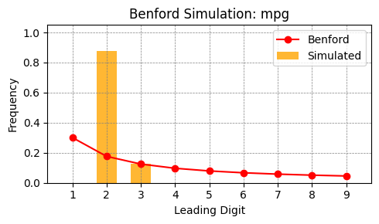
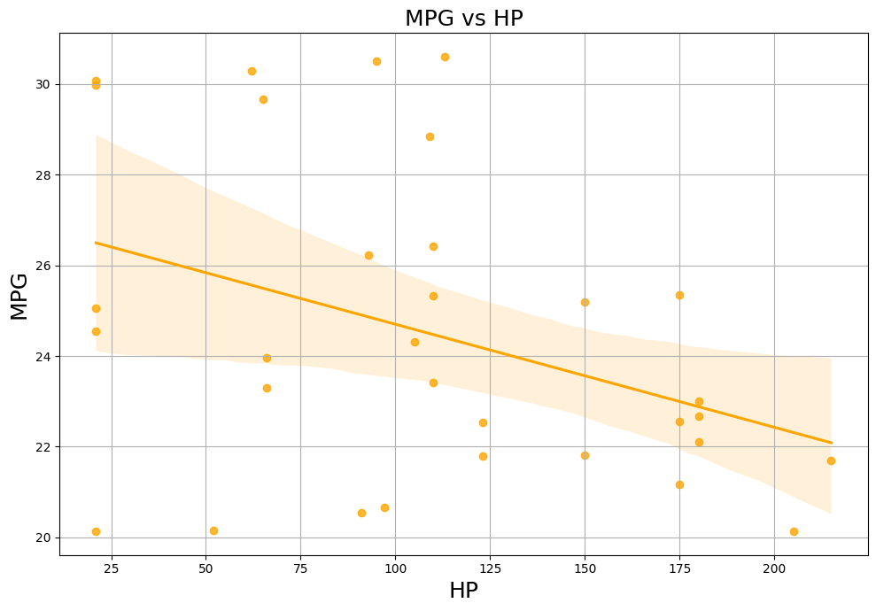
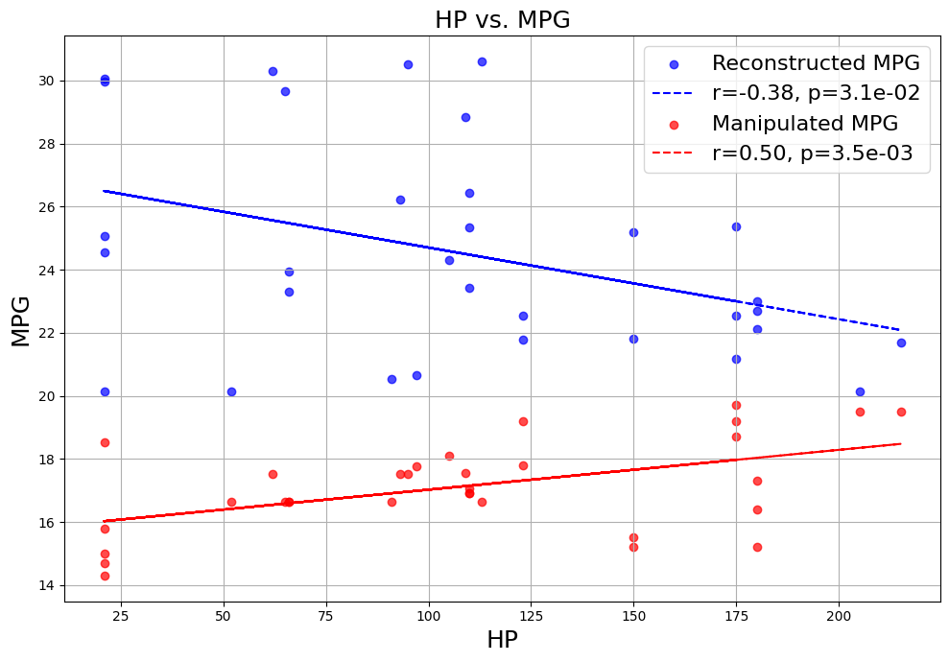
Detect Correlation Reversal using Benford’s Law
Stochastic Simulation
Reconstructed Data
Negative
Correlation

Slide 5
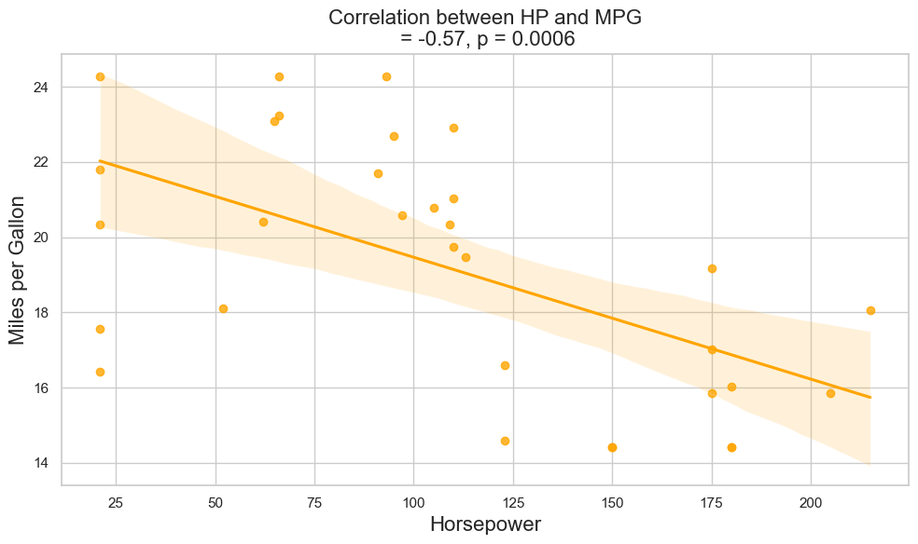
Detect Correlation Reversal using Random Forest
Original Data
Training
RF Model
Manipulated Data
Reconstructed Data
Regression
Negative
Correlation
RF Model

Slide 6
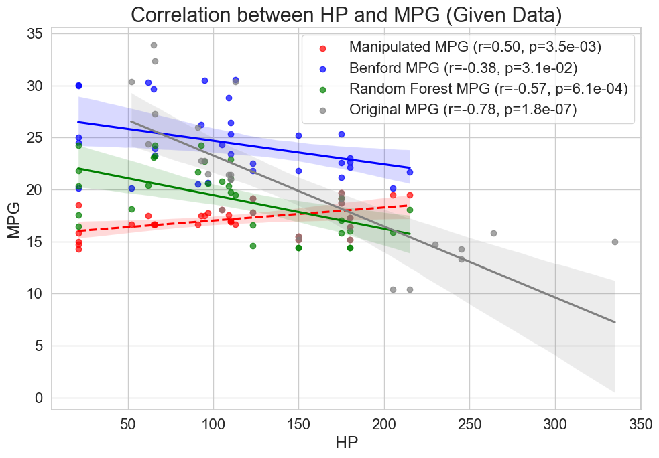
“The more horsepower we have,
the fewer miles per gallon we get.”

Slide 7
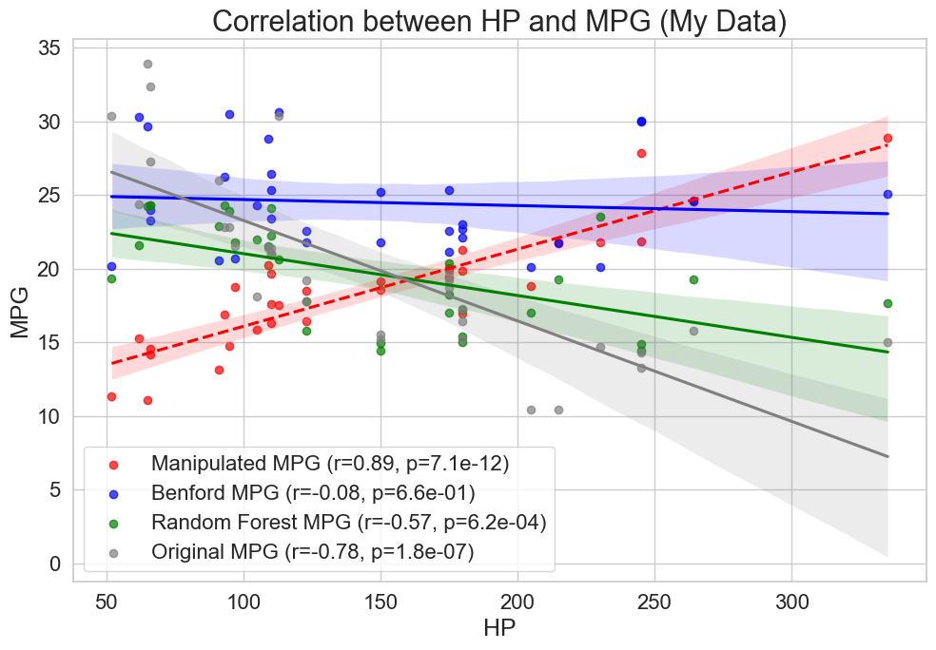
“The more horsepower we have,
the fewer miles per gallon we get.”

